Slide 1
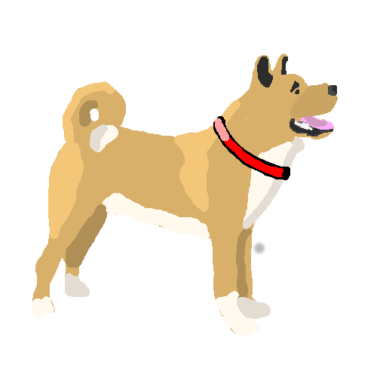
BARK! Created by N-Tier The Matrix
Paul Cowie, Lewis Dicks, Michael McKay, Ewan McCartney

Slide 2
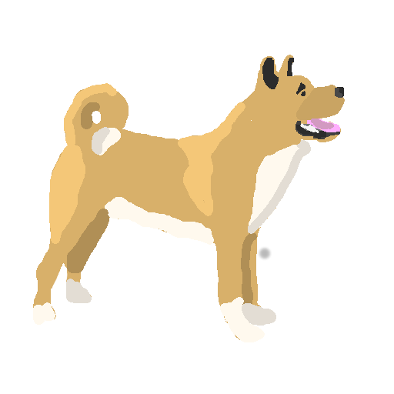
Overview
A student oriented, fun, friendly CompSci themed discussion forum.
An easy to use, personalised, customisable experience
Users can browse or follow tags, customising their homepage
Reserved tags for universities, special groups. Users have to be verified/accepted to post in these groups.
Positive voting encourages a positive atmosphere
Not restricted to questions, general discussions welcome

Slide 3
Requirements
MUST
Post questions or content (once signed in)
Email address validated to determine which university/college they go to
Restricted institution tagged posts for students in a specific university/college
Comment on existing posts or content, and rate others' content, with a positive scale
Search content by one or more tags
Subscribe to tags to view their posts easily on their homepage
SHOULD
Post or comment 'anonymously'
Display total likes, number of comments on profile page
Have tutorial/explanation/help available at any time if users get stuck
Have content that the user is interested in should be shown more often
COULD
Have email notifications when a post a user makes is commented on, etc
View 'Most Helpful' users, incentivising contributing and helping others
Have more types of 'special tags', like the university/college tags

Slide 4

User Personas
Jim, 17
Just started Comp Sci
At Bristol University
Thinks Python is
really neat.
Likes to make hobby programs along with the work he does at University.
In one of this lectures he's baffled by the concept of dictionaries in Python and the lecturer wasn't making it any easier to understand.
Notes:
Jim can go onto our website and search for the tags @python and @dictionary
He’ll also search for post from his own University by using the special @bristol.ac.uk tag.
The combination of tags leads him to posts from other people in his course who are struggling with the same things and so can quickly find an answer!

Slide 5

User Personas
Dave, 22
Aspiring PhD student
A programming guru
Knows everything about
every programming
language he can find, from COBOL to Python.
Wants to impart all his knowledge to others and achieve a high rating for his answers.
Notes:
He can browse BARK! for programming tags e.g. @java and look for unanswered questions in which he can answer. Many students would appreciate it. He gets a buzz out of answering questions and enjoys a large "score", as many people find his answers helpful.

Slide 6
User Needs Matrix
Feature | Jim | Dave | Total
Add A Post/Comment | 5 | 5 | 10
Restrict Post Contributors | 5 | 3 | 8
Rating System | 2 | 5 | 7
Tag Subscription | 3 | 5 | 8
Anonymous Posting | 4 | 1 | 5

Slide 7
URL Mapping
Description | Mapping
Posts/Questions | /posts/postId/post-title-slug
View Tags | /posts/tags/tag1+tag2+...
New Posts | /posts/new/tag1+tag2+...
Add a new post | /posts/bark
Tag Search | /search?q=tag1+tag2+...
User Profile | /user/username

Slide 8
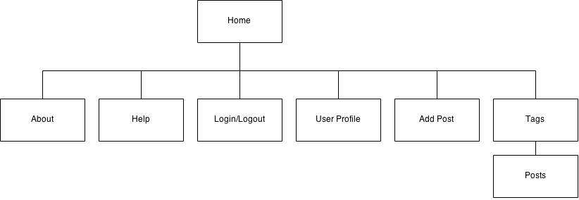
Site Map

Slide 9
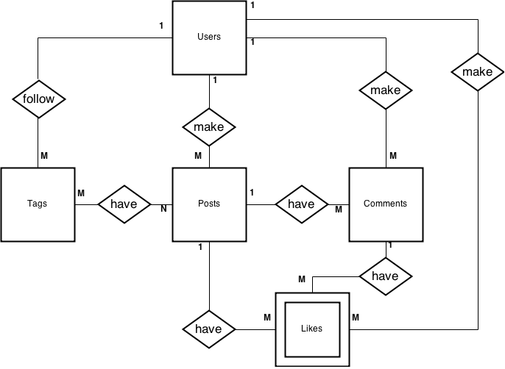
ER Diagram

Slide 10

n-Tier Diagram

Slide 11
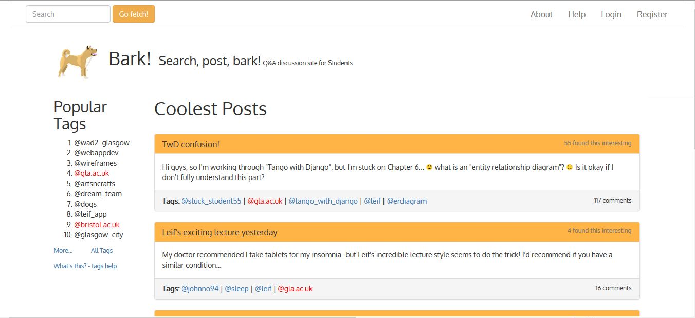
Wireframes – index page

Slide 12
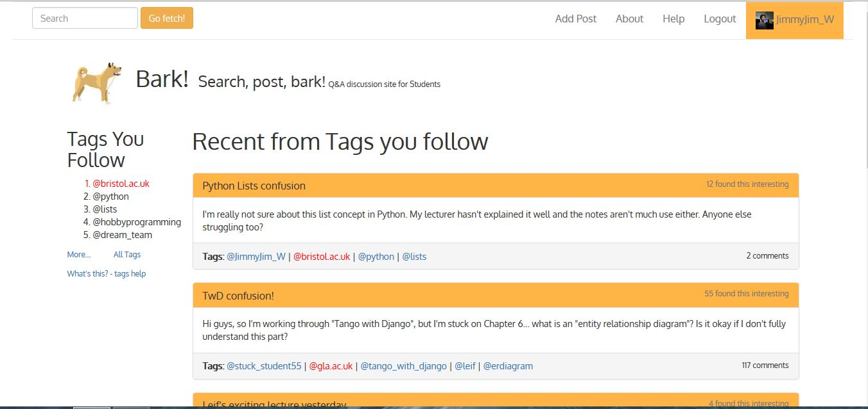
Wireframes – logged in homepage

Slide 13
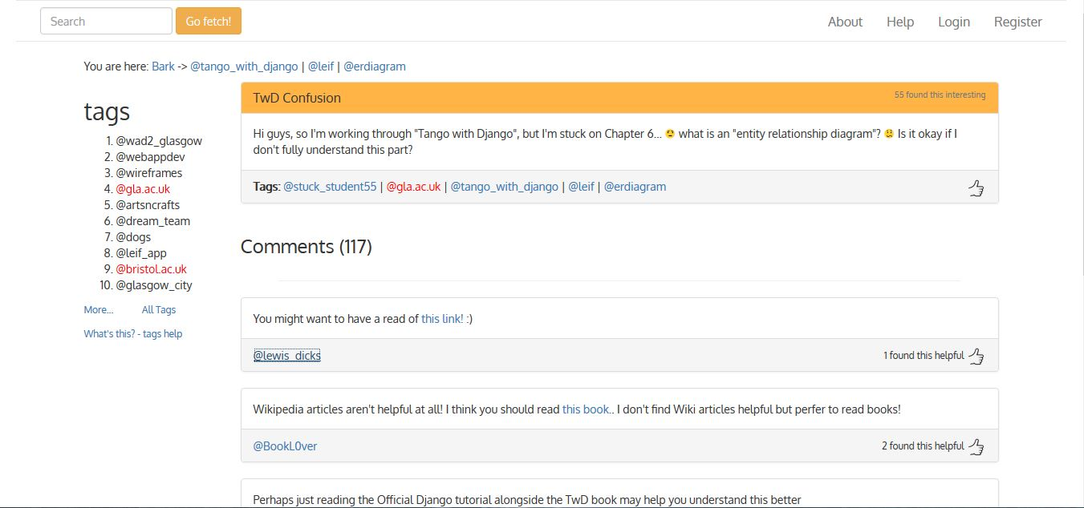
Wireframes – post view

